Slide 1
Workflow pitch
Door: Rubin Versigny, Youri Vos en Pien van Vugt
Datum: 25-03-2021
Vak: NGS

Slide 2
Inhoud
Workflow
Species
Assembly
Resistance genes in the bacteria

Slide 3
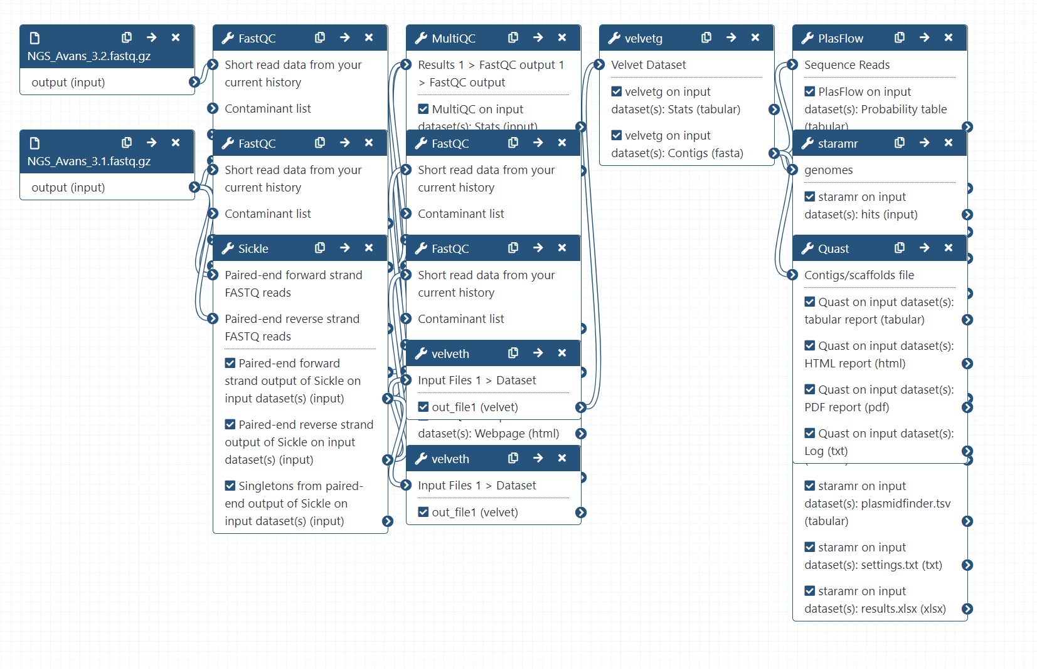
Workflow Velvet

Slide 4
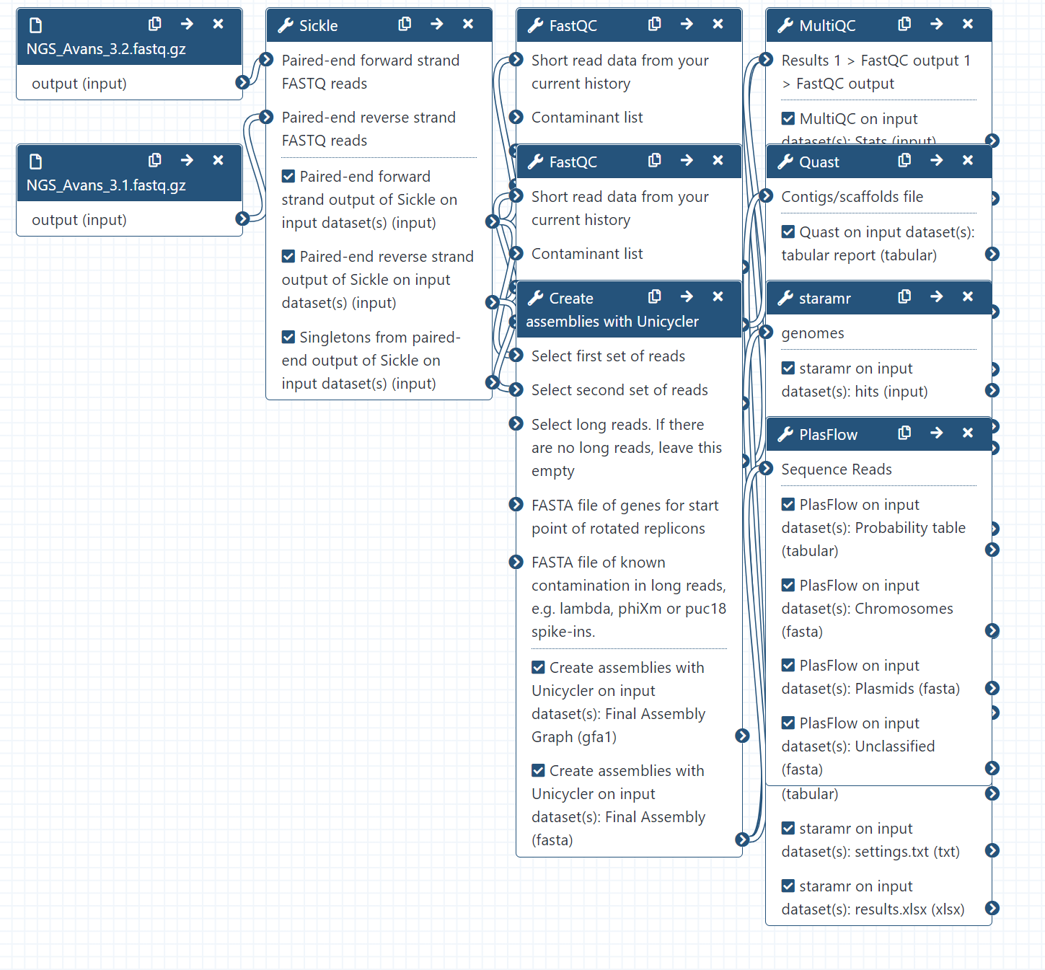
Workflow Unicycler

Slide 5
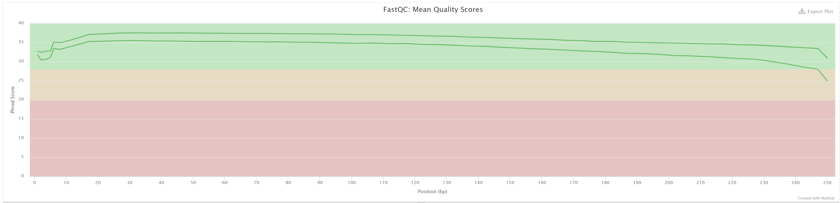
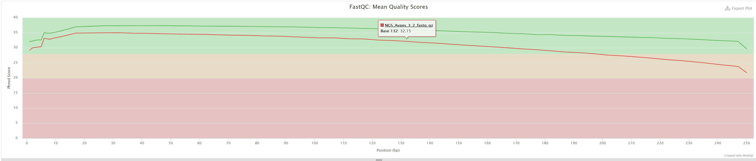
Sickle

Slide 6
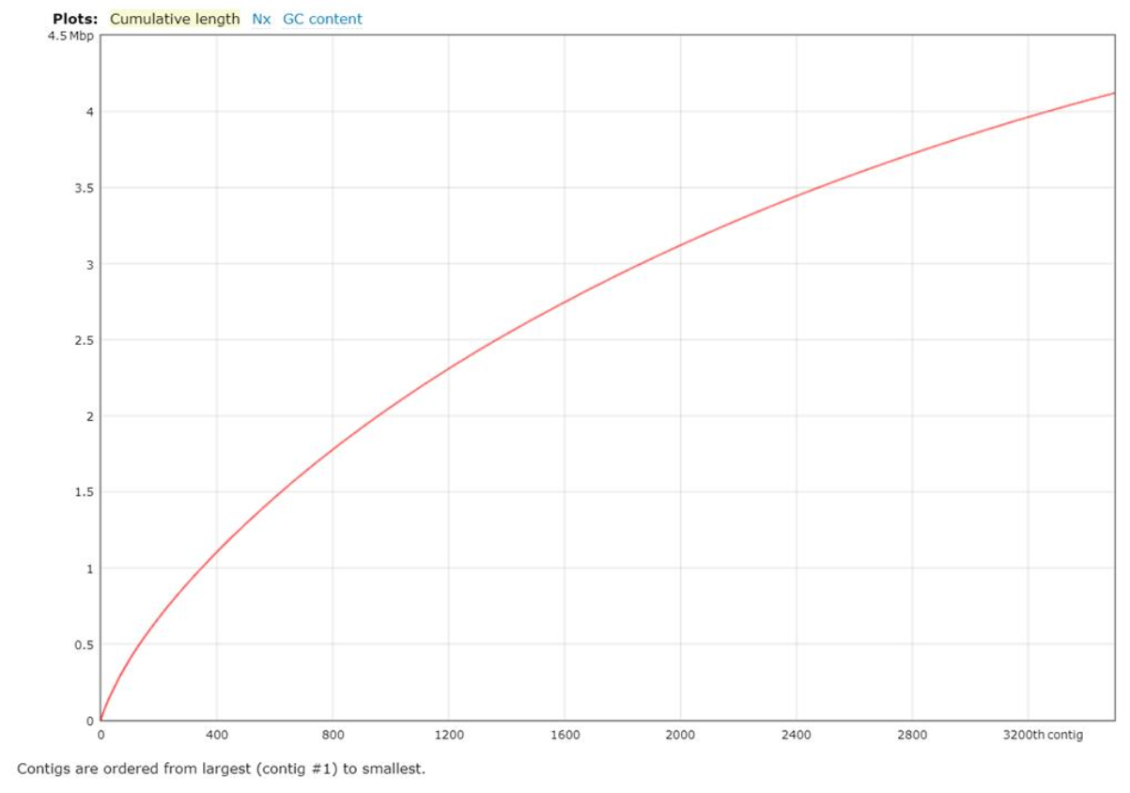
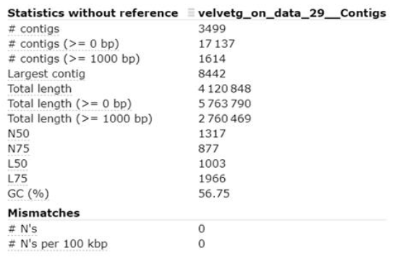
Quast Velvet

Slide 7
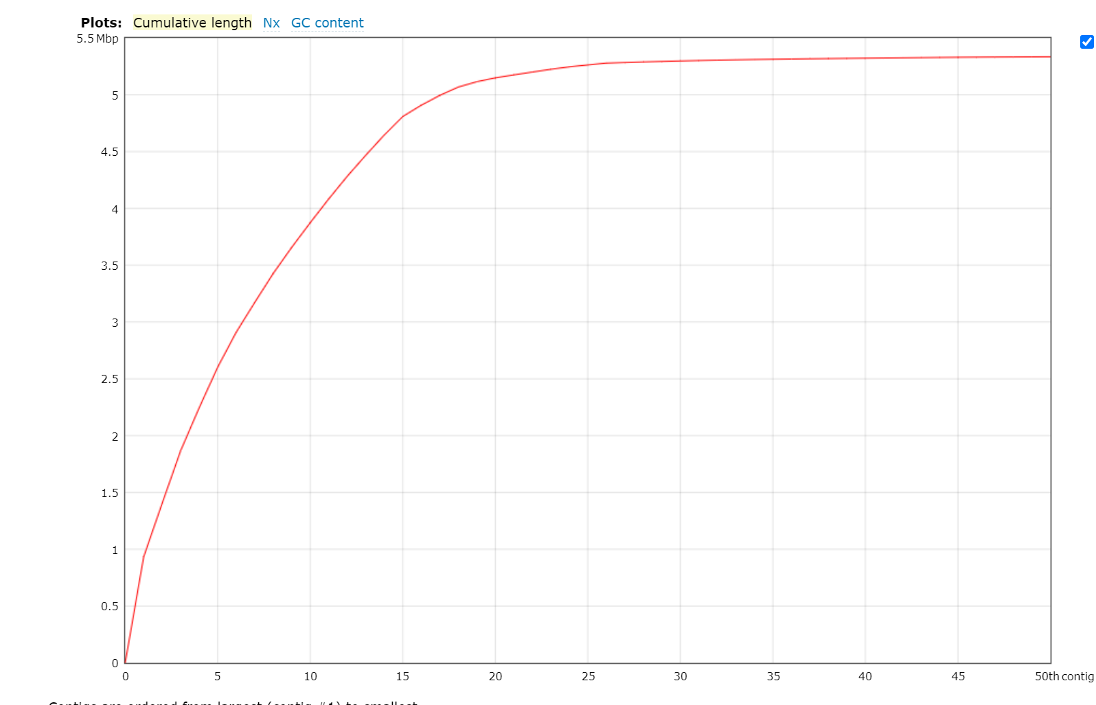
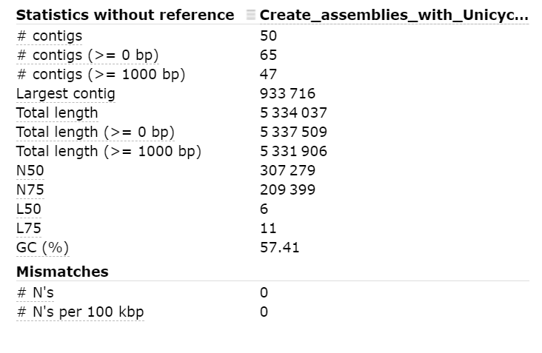
Quast Unicycler

Slide 8
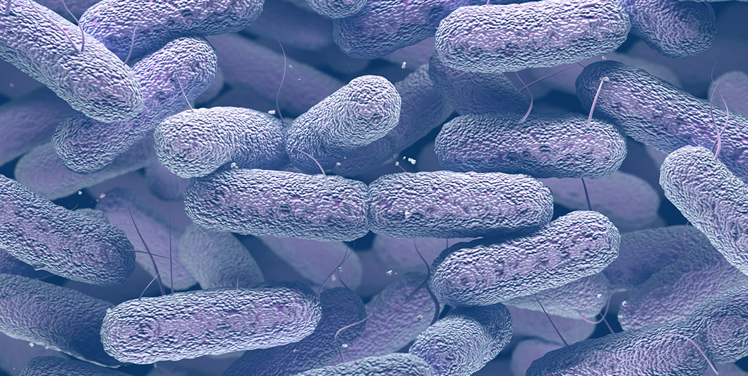
Klebsiella pneumonia

Slide 9
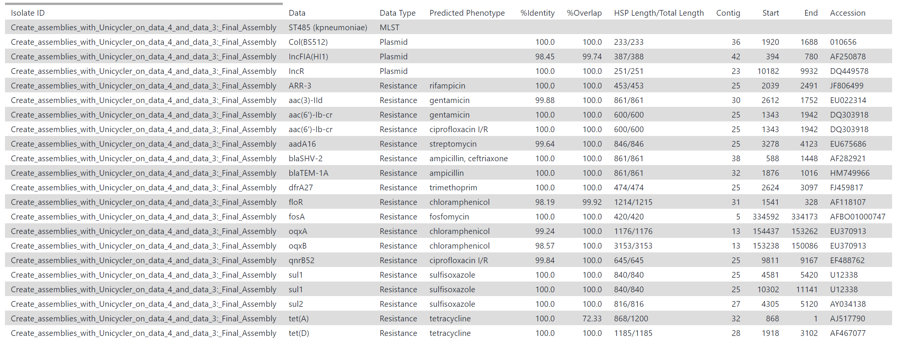
Staramr

